Slide 1



Clinical Data Quality Check Workflow
Detect and flag inconsistencies in clinical datasets before downstream analysis.
Presented By,
Kesavan M
2026 - https://www.agilisium.com

Slide 2
The Complexity of Clinical Data Quality Check
  High Volume Data Errors: Manual entry leads to frequent typos, outliers, and missing values. Simple validation rules often miss context-dependent anomalies in large clinical datasets.
  Privacy & Compliance Risks: Sensitive Patient Health Information (PHI/PII) is strictly regulated and cannot be sent to public cloud AIs for analysis due to data leakage risks.
  Expert Bottleneck: Validating medical data requires clinical expertise. Relying on physicians to clean data is expensive, scarce, and significantly slows down research timelines.
  Lack of Contextual Insights: Standard validation tools merely flag errors (e.g., "Error 404") but fail to explain why a value is clinically suspicious, forcing manual investigation.
2026 - https://www.agilisium.com

Slide 3
Problem Statement
Clinical datasets frequently suffer from a wide range of data quality issues, including missing values, inconsistencies, incorrect formats, and statistical outliers. These issues can seriously compromise patient safety, reduce the reliability of clinical studies, and impact regulatory compliance. Most traditional data validation tools are limited to simply flagging anomalies based on predefined rules, without considering the underlying clinical context or real-world relevance of the data. As a result, data stewards and clinical analysts are forced to manually review large volumes of flagged records, which is time-consuming, error-prone, and inconsistent across teams. This manual burden slows down the data cleaning process, delays downstream analysis, and ultimately affects the speed and accuracy of clinical decision-making and research outcomes.
2026 - https://www.agilisium.com

Slide 4
Strategic Solution
The Clinical Data Quality Intelligence Platform automates data validation and provides expert-level clinical insights. It combines rigorous error checking with an intelligent AI "Virtual Data Scientist" to not just detect issues but explain their clinical impact and recommend fixes.
Key Features:
Automated Validation: Instantly detects schema violations, missing data, and outliers.
Smart Caching: Utilizes a Vector Database (ChromaDB) to memorize and reuse explanations for recurring issues, ensuring speed and consistency.
AI-Powered Analysis: Uses a local AI model (DeepSeek) to provide detailed observations, clinical impacts, and remediation steps for every error.
Actionable Reporting: Delivers clear, prioritized insights via an interactive dashboard and PDF reports.
2026 - https://www.agilisium.com

Slide 5
Why Existing Search Methods Fail
  Rigidity: Keyword-based searches fail to handle fuzzy or inconsistent clinical terminology (e.g., “Temp” vs “Body Temperature”).
  Isolation: Data values are evaluated without clinical context or patient history, leading to misleading alerts.
  Maintenance Overhead: Hardcoded validation rules do not scale well across diverse studies, protocols, and research datasets.
  Decision Lag: Lack of actionable intelligence delays remediation, slowing down clinical analysis and decision-making.
2026 - https://www.agilisium.com

Slide 6
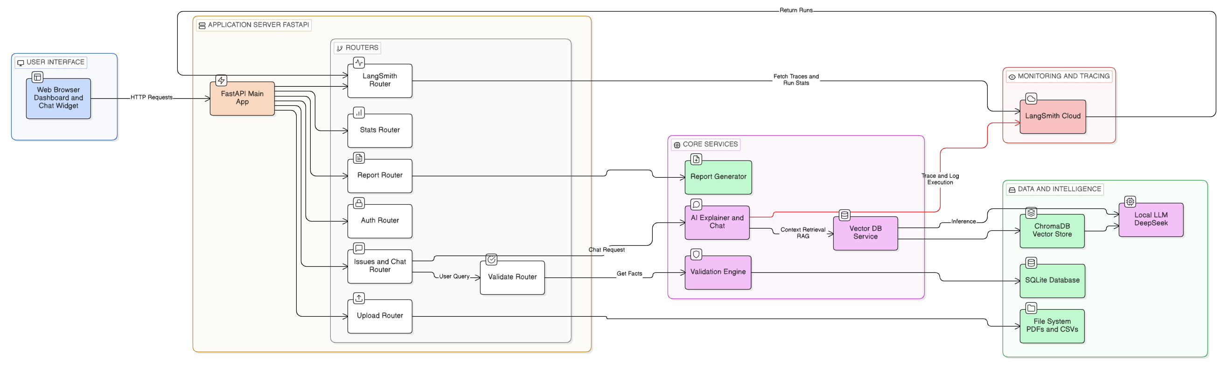
High-Level System Architecture
2026 - https://www.agilisium.com

Slide 7
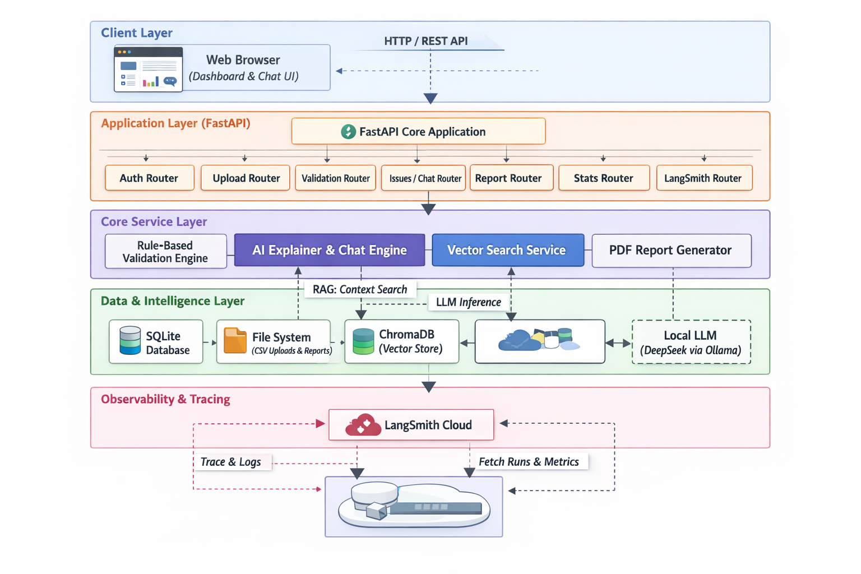
Flow Diagram
2026 - https://www.agilisium.com

Slide 8
  The Document Ingestion Pipeline
Structured Text Extraction: Supports ingestion from CSV, PDF, and plain text files, automatically parsing structured and semi-structured clinical data.
Vectorization Pipeline: Applies efficient chunking strategies and generates high-quality embeddings to preserve semantic meaning across documents.
Vector Storage: Integrates with ChromaDB to enable persistent, fast, and scalable vector indexing for semantic search and retrieval.
Persistent Knowledge Mapping: Maintains a traceable link between source documents and vector representations, ensuring explainability and auditability.
Batch Processing & Scalability: Supports bulk ingestion of multiple documents, enabling scalable processing for large-scale clinical and research datasets.
2026 - https://www.agilisium.com

Slide 9
Semantic Chunking
Large clinical documents are split into meaningful concept-based chunks rather than fixed sizes. The system first performs sentence-level parsing, then groups sentences based on semantic continuity, using embedding-distance breakpoints to detect topic shifts. This ensures related clinical information (e.g., vitals + measurement context) remains intact, giving the LLM a coherent and complete context during retrieval.
Vector Similarity
Each chunk is converted into a 384-dimensional embedding using all-MiniLM-L6-v2. During queries, the system applies cosine similarity to compare the query vector with stored vectors, retrieving semantically related content even when keywords differ (e.g., “incorrect age” ↔ “age out of protocol range”).
Vector Storage & Indexing:
Embeddings are stored persistently in ChromaDB, organized into domain-specific collections. The database uses HNSW indexing for fast similarity search and maintains rich metadata mapping (UUID, source file, timestamp, patient context), ensuring every retrieved insight is traceable and auditable.
2026 - https://www.agilisium.com

Slide 10
Local Inference with Ollama & Mistral
On-Premise Generation: Uses Ollama to run the DeepSeek model locally, ensuring zero data leakage and full control over sensitive information.
Grounded Prompting: The model is explicitly constrained to respond only using retrieved SOP and knowledge-base context, preventing hallucinations.
Privacy-Native Design: Well-suited for regulated environments (healthcare, clinical research, compliance) where cloud-based AI is restricted or prohibited.
Natural Language Synthesis: Transforms raw retrieved chunks into clear, structured, and actionable procedural guidance for end users.
Resource-Efficient Inference: Leverages lightweight models (e.g., DeepSeek-R1 / Mistral) to deliver high performance without requiring expensive cloud compute.
2026 - https://www.agilisium.com

Slide 11
  End-to-End Runtime Workflow
Request Trigger (FastAPI): User clicks Validate → frontend sends a POST request. The backend streams progress updates in real time, enabling responsive UI feedback during validation.
Data Preparation & Isolation (Database Layer): A dynamic, dataset-specific table is created to ensure isolation across studies and prevent data overlap.
Rule-Based Validation Pass (Validator Service): Clinical rules and statistical checks detect logic errors, protocol deviations, and biologically implausible outliers (IQR-based).
AI Intelligence Pass (LLM + Vector DB): Each issue is semantically matched against ChromaDB.
If a similar case exists → reuse explanation. If new → DeepSeek-R1 (via Ollama) generates a clinical explanation. New insights are embedded and stored, enabling continuous learning.
Persistence & Analytics (SQL Layer): All findings and AI explanations are stored, and global integrity scores are recalculated for dashboard visualization.
Reporting & Output (Report Generator): Validated data and AI insights are compiled into a professional audit report with summaries, severity insights, and remediation guidance.
2026 - https://www.agilisium.com

Slide 12
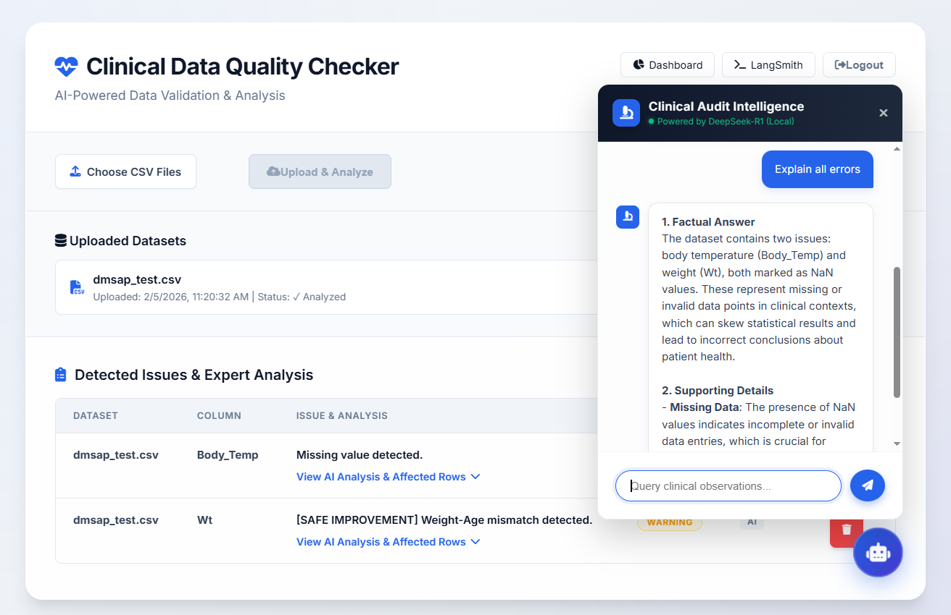
Clinical Data Quality Check Workflow UI
2026 - https://www.agilisium.com

Slide 13
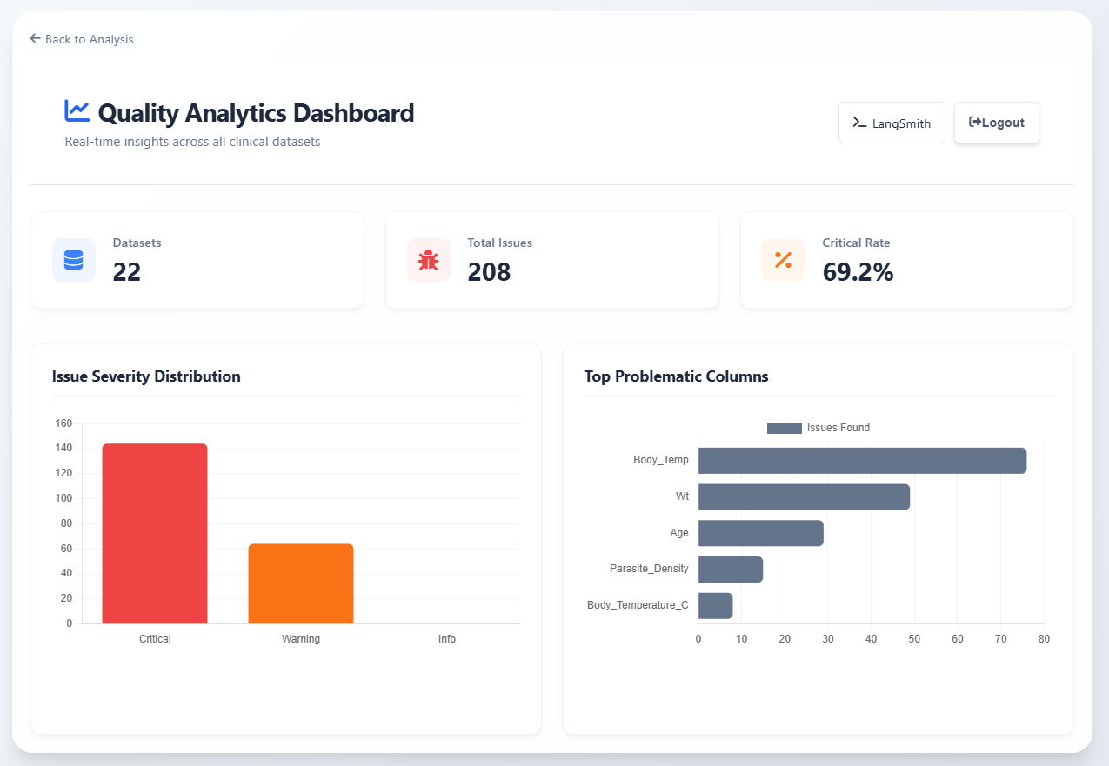
Quality Analytics Dashboard
2026 - https://www.agilisium.com

Slide 14
Monitoring via Langsmith
LangSmith serves as the observability and monitoring layer for all AI-driven operations, providing full visibility into how the DeepSeek-R1 model reasons over clinical data.
Trace Definition: A trace is a complete log of a single AI interaction, capturing the input clinical data, the prompt, the model’s reasoning, and the final explanation, along with metadata such as model version and tags.
Hierarchical Execution (Runs): Traces are structured into parent and child runs, representing high-level tasks (dataset analysis) and sub-steps (semantic search, LLM completion). This enables precise root-cause analysis when validation issues occur.
Key Metrics Monitored: The system tracks latency (p50/p95/p99), error rates, and token usage, helping identify performance bottlenecks and AI reliability issues.
Operational Insight: Trace statistics feed the Intelligence Dashboard, showing audit volume, success vs. failure rates, and step-by-step reasoning for transparent and explainable clinical decisions.
2026 - https://www.agilisium.com

Slide 15
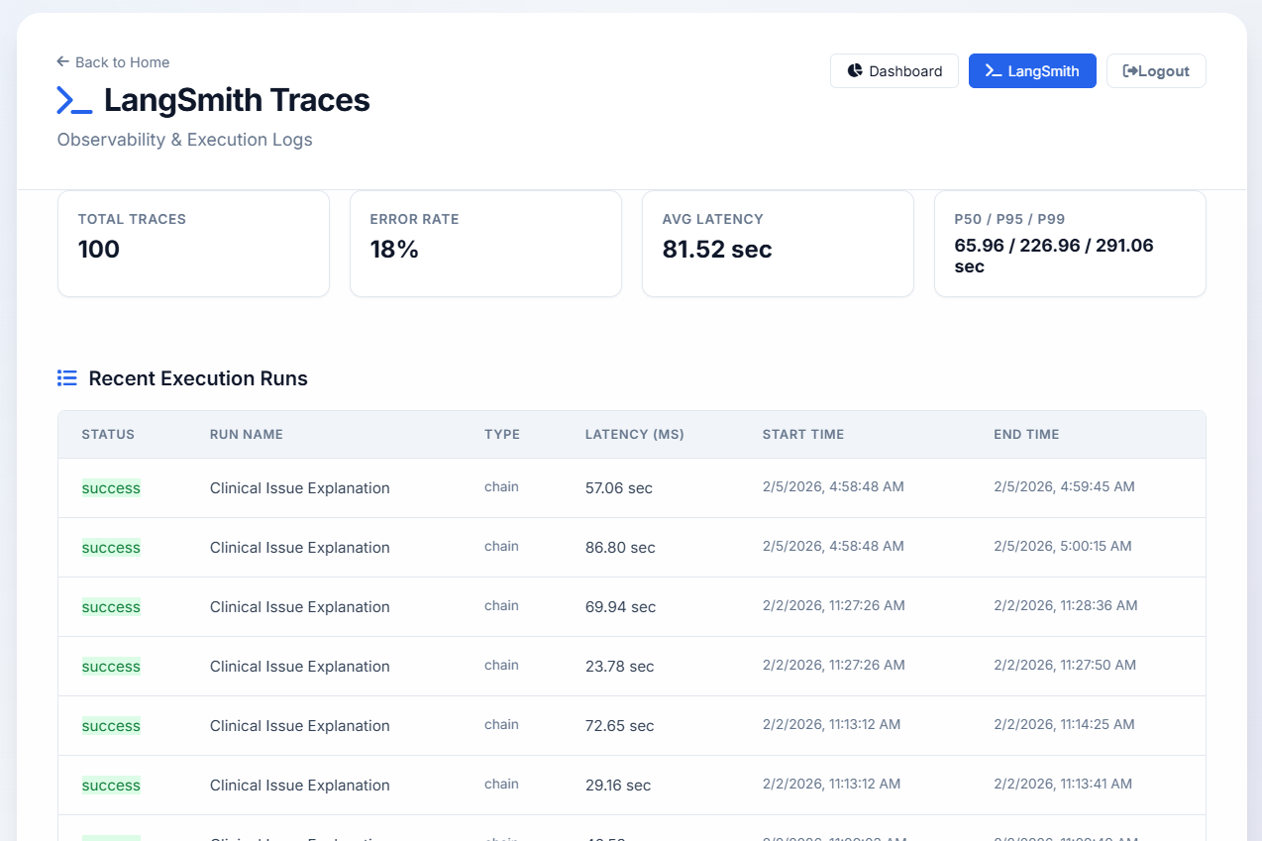
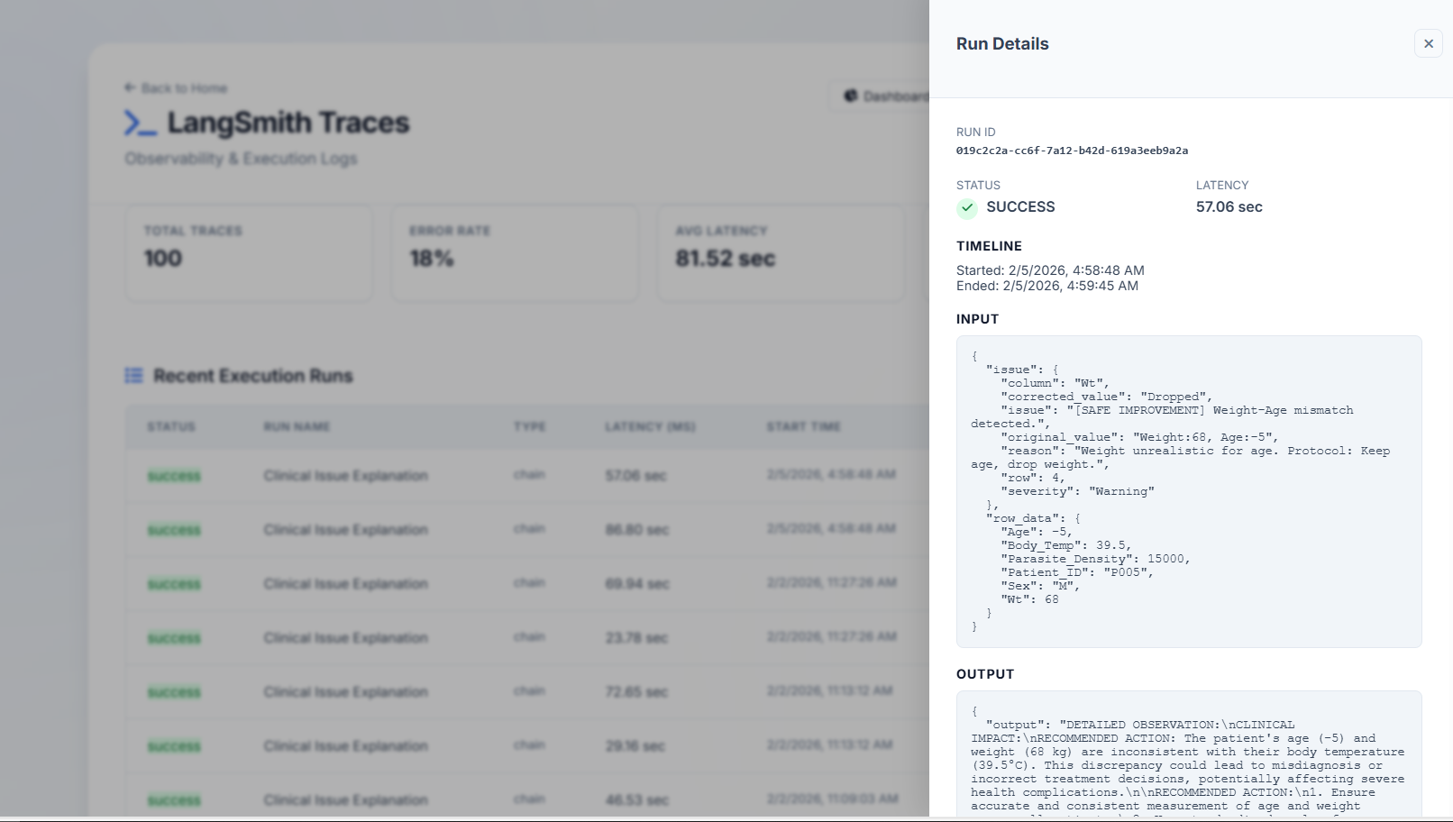
Langsmith Traces
2026 - https://www.agilisium.com

Slide 16
Results & Operational Impact
Performance: Low-latency AI enabled by asynchronous processing and semantic caching, designed to scale efficiently for large clinical datasets.
Accuracy: End-to-end validation of 100% of records using semantic similarity to ensure consistent and reliable issue detection.
Support: Explainable AI powered by LangSmith traces, with automatically generated clinical explanations and remediation guidance.
Reduction: Achieves up to a 70% reduction in audit timelines by minimizing manual review and human-introduced errors.
Accessibility: Real-time integrity dashboards combined with a shared clinical knowledge base for organization-wide visibility.
2026 - https://www.agilisium.com

Slide 17
Conclusion
The Clinical Data Quality Intelligence Platform marks a shift from manual, error-prone validation to an automated, AI-driven audit ecosystem, addressing critical challenges in research integrity, scalability, and trust.
Key Outcomes:
Operational Excellence: Reduced manual audit effort by 70%+, allowing teams to focus on patient safety and scientific outcomes.
Intelligent Memory: Built a self-evolving semantic knowledge base, enabling every audit to benefit from historical clinical insights.
Unified AI Pipeline: Seamlessly integrates DeepSeek-R1 (reasoning), ChromaDB (semantic retrieval), and LangSmith (observability) into a transparent, end-to-end system.
Impact: Faster audits, consistent intelligence, and compliance-ready clinical decision support.
2026 - https://www.agilisium.com

Slide 18
Future Directions
Adaptive Intelligence: Continuously learns from evolving clinical protocols and regulatory updates to remain compliant and context-aware.
Multi-Modal Validation: Expands beyond tabular data to include medical images, lab reports, and device-generated clinical signals.
Federated Knowledge: Enables secure cross-study and cross-institution intelligence exchange while preserving data privacy.
Human-in-the-Loop: Integrates expert validation and feedback to strengthen trust, accuracy, and accountability.
Predictive Risk Detection: Proactively identifies potential data quality issues and protocol deviations before they impact studies.
2026 - https://www.agilisium.com

Slide 19



Thank You

